Slide 1
Knee Assessment
Dr. Sanket Mungikar
Dept Of Musculoskeletal Physiotherapy
MGM Institute Of Physiotherapy
Chh.Sambhajinagar

Slide 3
Introduction
The tibiofemoral joint is the largest joint in the body. It is a modified hinge joint having 2° of freedom. The synovium around the joint is extensive; it communicates with many of the bursae and pouches around the knee joint.
The articular surfaces of the tibia and femur are not congruent, which enables the two bones to move different amounts, guided by the muscles and ligaments. The two bones approach congruency in full extension, which is the close packed position.
.

Slide 4
The space between the tibia and femur is partially filled by two menisci that are attached to the tibia to add congruency. The medial meniscus is a small part of a large circle (i.e., C shaped) and is thicker posteriorly than anteriorly. The lateral meniscus is a large part of a small circle (i.e., O shaped) and is generally of equal thickness throughout. Both menisci are thicker along the periphery and thinner along the inner margin.
The menisci serve several functions in the knee. They aid in lubrication and nutrition of the joint and act as shock absorbers (a meniscectomy can reduce shock absorption capacity at the knee by 20%),4 spreading the stress over the articular cartilage and decreasing cartilage wear. They make the joint surfaces more congruent and improve weight distribution by increasing the area of contact between the condyles. The menisci reduce friction during movement and aid the ligaments and capsule in preventing hyperextension.

Slide 5
The patellofemoral joint is a modified plane joint.
During the movement from flexion to extension, different parts of the patella articulate with the femoral condyles.
Incorrect alignment or malalignment of the patellar movement over the femoral condyles can lead to patellofemoral arthralgia. The capsule of this joint is continuous with the capsule of the tibiofemoral joint.
The patella improves the efficiency of extension during the last 30° of extension (i.e., 30° to 0° of extension with the straight leg being 0°), because it holds the quadriceps tendon away from the axis of movement. The patella also functions as a guide for the quadriceps or patellar tendon, decreases friction of the quadriceps mechanism, controls capsular tension in the knee, acts as a bony shield for the cartilage of the femoral condyles, and improves the aesthetic appearance of the knee

Slide 6
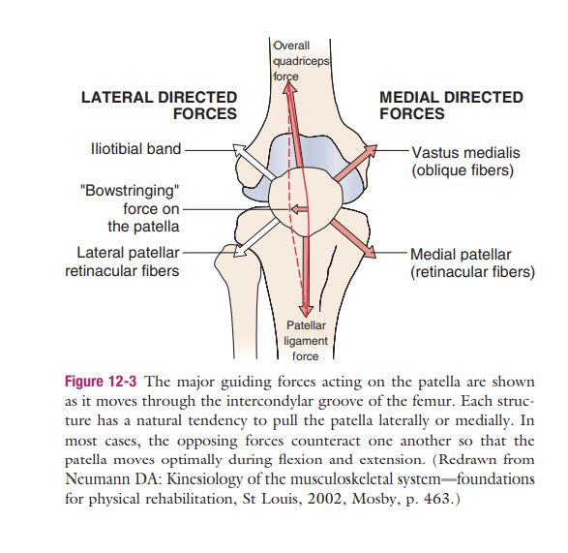

Slide 7
Patients history
1.How did the accident occur, or what was the mechanism of injury?
The primary mechanisms of injury in the knee are a valgus force (with or without rotation), hyperextension, flexion with posterior translation, and a varus force.
The first often results in injury to the medial collateral ligament, frequently accompanied by injury to the posteromedial capsule, medial meniscus, and anterior cruciate (“terrible triad”).
The second leads to anterior cruciate injuries, often associated with meniscus tears.
The third mechanism of injury often involves the posterior cruciate ligament.
fourth mechanism involves the lateral collateral ligament, the posterolateral capsule, and the posterior cruciate ligament

Slide 8
2.Has the knee been injured before, or does it have any feeling of weakness?
3.What is the patient able or unable to do functionally? Is there disability on running, cutting, pivoting, twisting, climbing, or descending stairs?
4. Is there any “clicking,” or was there a “pop” when the injury occurred.
5.Did the injury occur during acceleration, during deceleration, or when the patient was moving at a constant speed? Acceleration and twisting injuries may involve the meniscus. Deceleration injuries often involve the cruciate ligaments. Constant speed with cutting may involve the anterior cruciate ligament.

Slide 9
6Is there any pain? If so, where? What type is it? Retropatellar? Does the 6.patient point to one spot with one finger or a more general area indicating the problem is more diffuse, aching?
Aching pain may indicate degenerative changes, whereas sharp, “catching” pain usually indicates a mechanical problem.
Arthritic pain is more likely to be associated with stiffness in the morning and eases with activity.
Anterior knee pain may be due to patellofemoral problems, bursa (prepatellar, infrapatellar) pathology, fat pad pathology, tendinosis, or Osgood-Schlatter disease. Patellofemoral pain tends to be insidious and occurs spontaneously, often from overuse
Pain during activity is usually seen in structural abnormalities, such as subluxation or patellar tracking disorders.
.

Slide 10
Pain after activity or with overuse is characteristic of inflammatory disorders, such as synovial plica irritation or early tendinosis or paratenonitis leading to jumper’s knee or Sinding-Larsen-Johansson syndrome.
Generalized pain in the area of the knee is usually characteristic of contusions or partial tears of muscles or ligaments. the source of the problem important.
Pain in the knee on ankle movements may implicate the superior tibiofibular joint
7.Do certain positions or activities have an increased or decreased effect on the pain? Which activities produce pain? How much activity is needed to produce pain? Which positions or activities ease the pain? Does the pain go away when activity ceases?

Slide 11
8.Does the knee “give way?” This finding usually indicates instability in the knee, meniscus pathology, patellar subluxation (if present when rotation or stopping is involved), undisplaced osteochondritis dissecans, patellofemoral syndrome, plica, or loose body. Giving way when walking uphill or downhill is more likely the result of a retropatellar lesion. If the patient complains that the patella “slips out of place,” it may be because of patellar subluxation or a pathological plica.
9.Has the knee ever locked? True locking of the knee is rare. Loose bodies may cause recurrent locking. Locking must be differentiated from catching.
Locking in the knee usually means that the knee cannot fully extend with flexion often being normal, and it is related to meniscus pathology. Hamstring muscle spasm may also limit extension and is sometimes referred to as spasm locking.

Slide 12
10.On movement, is there any grating or clicking in the knee? Grating or clicking may be caused by degeneration or by one structure’s snapping over another.
11.Is the joint swollen? Does the swelling occur with activity or several hours after activity, or does the joint feel tight at rest?
12.Is the gait normal? Does the patient put weight on the limb? Can the patient extend the knee while walking? Is the stride length altered on the affected limb? All these questions give an indication of the patient’s functional disability and how much the knee is bothering the patient.
13. What type of shoes does the patient wear? Shoes with negative heels (e.g., “earth shoes”) can increase the incidence of patellofemoral syndrome.

Slide 13
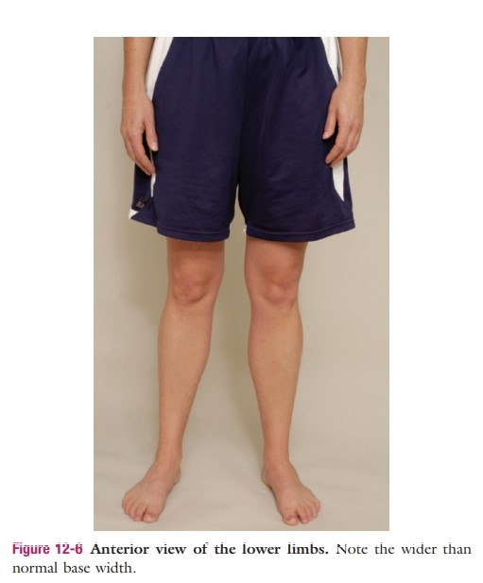
Observation
Anterior view :

Slide 14
Demormity in anterior view

Slide 17
Posterior view

Slide 19
Anterior and lateral view in sitting

Slide 20
Examination
Active movements .
Passive movements.
Patellar movements .
Resisted isometric .
Reflexes-
Patella Ligament (L3/L4)
Achilles Tendon (S1/S2)
Dermatomes
L1 to S4

Slide 21
Myotomes
L2 Hip Flexion
L3 Knee Extension
L4 Dorsiflexion
L5 Big Toe Extension OR 4 Lesser Toes Extension
L5/S1 Knee Flexion
S1 Plantarflexion OR Foot Eversion
S2 Toe Flexion

Slide 22
Functional Tests
Small knee bend
Sit to stand
Squat
Jump
Hop
Run

Slide 23
THANK YOU

